Slide 1
元學習 Meta Learning

Slide 2
META LEARNING: OUTLINE
What is “Meta Learning”
Basic Concept
Learning Methods and Algorithms
Summarize

Slide 3
What is “Meta Learning”

Slide 4
What is “Meta Learning”: Learning Algorithm
Can we learn this?
Training Data
(input)
Learning Algorithm
Basic
Machine
Learning
Testing Data
Model
Output

Slide 5
What is “Meta Learning”: Meta Learning vs. Machine Learning
Machine Learning
Meta Learning
Learning Algorithm
Unknown Function
Find “learnable thing”
Define “loss function”
Define “loss function”
Optimize
Minimize loss function

Slide 6
What is “Meta Learning”: Meta Learning vs. Machine Learning
 | Machine Learning | Meta Learning
學習方式 | 針對單一任務 | 多個相關任務
訓練樣本 | 需要大量資料 | 資料需求較少
泛化能力 | 在新任務中表現不佳 | 能叫快速適應新任務

Slide 7

What is “Meta Learning”: Learning to Learn
Outer-level Learning
Inner-level
Learning
(lifetime)
slow
medium
fast
Slow Learner
Medium Learner
Fast Learner

Slide 8
Basic Concept

Slide 9
Basic Concept: Multi-Task
Learning Task
Inner
Level
Train Task 1
Train Task 2
．．．．．．
Train Task n
Outer
Level
Policy Gradient

Slide 10



Basic Concept: Meta Data
Image Classification
(fish, dog, bird)
Meta Data
Image Classification
(fish, dog)
Image Classification
(fish, bird)
Image Classification
(dog, bird)

Slide 11
Learning Methods and Algorithms

Slide 12




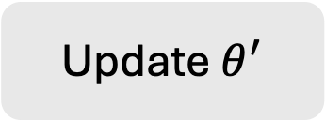
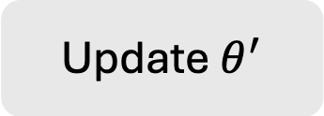
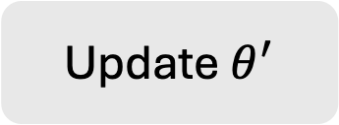
Learning Methods and Algorithms: MAML
Support Set
Inner
Gradient
Descent
Update $θ^{′}$
Loss
Gradient
Descent
Update $θ^{′}$
Loss
Gradient
Descent
Update $θ^{′}$
Loss
Outer
Query Set

Slide 13






Learning Methods and Algorithms: MAML
$$∇ℒ_{1}$$
$$∇ℒ_{2}$$
$$θ_{1}^{∗}$$
𝜃
$$θ_{2}^{∗}$$
$$∇ℒ_{3}$$
$$θ_{3}^{∗}$$

Slide 14
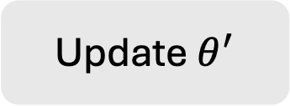
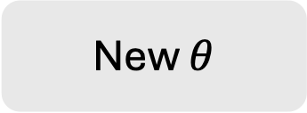
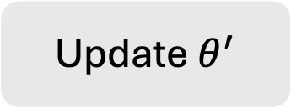

Learning Methods and Algorithms: Reptile
Train
Update $θ^{′}$
Train
Update $θ^{′}$
New $θ$
Train
Update $θ^{′}$

Slide 15





Learning Methods and Algorithms: Reptile
Sample a training task m
$$θ^{m}$$
$$θ^{0}$$
$$θ^{1}$$
$$θ^{2}$$
$$θ^{n}$$
Sample a training task n

Slide 16
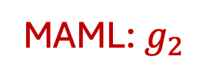
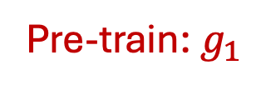
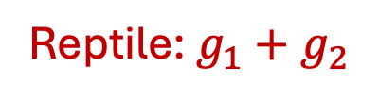
Learning Methods and Algorithms: Pre-train vs. MAML vs. Reptile
Pre-train: $g_{1}$
Reptile: $g_{1}+g_{2}$
MAML: $g_{2}$

Slide 17
Learning Methods and Algorithms: MAML vs. Reptile
 | MAML | Reptile
優點 | 可以在樣本數較少時，快速適應新任務 | 簡單，計算成本低
缺點 | 計算複雜度高 | 表現可能不如MAML

Slide 18
Summarize

Slide 19
Meta Learning: Summarize
What is ”Meta Learning” | Learning to learn.
Basic Concept | Multi-task
Methods and Algorithms | MAML: 複雜但表現可能較好 Reptile: 簡單但表現可能較差

Slide 20
Meta Learning: Summarize
優勢 | 快速適應新任務 有效利用少量數據
挑戰 | 理論理解尚不完善

